Slide 1

PYTHON GUI DASTURLASH
PyQt5 da Matn Muharriri
Dasturi Dizayni
Python GUI Dasturlash va Cross-Platform Ilovalar Ishlab Chiqish
Python 3.x
Cross-Platform
GUI Toolkit
Zamonaviy versiya
Windows/Mac/Linux
Qt Framework

Slide 2
MAZMUN
Mundarija
01
PyQt5 Asoslari
05
Fayl Operatsiyalari
PyQt5 kutubxonasi, o'rnatish va asosiy tushunchalar
Fayllarni ochish, saqlash va boshqarish
02
QMainWindow Arxitekturasi
06
Matn Formatlash
Asosiy oyna tuzilishi va komponentlari
Qalin, kursiv va ostiga chizish
03
Asosiy Vidjetlar
07
Xatolarni Boshqarish
Matn muharriri uchun zarur vidjetlar
GUI dasturlarida xatolarni qayta ishlash
04
Menyu va Toolbar
08
Amaliy Misol
QAction orqali interfeys yaratish
To'liq matn muharriri dasturi kodi

Slide 3

BO'LIM 01
PyQt5 Asoslari
PyQt5 kutubxonasi, o'rnatish va asosiy tushunchalar

Slide 4
PYQT5 ASOSLARI
PyQt5 nima?
Umumiy Ma'lumot
O'rnatish
PyQt5 - bu Qt frameworkining Python bilan bog'lashi (binding). Riverbank Computing tomonidan yaratilgan bepul dasturiy ta'minot.
pip install pyqt5
Terminalda bajarish
440+
6000+
Sinf (Class)
Funksiya/Metod
import PyQt5
Python kodida import
Asosiy Modullar
Xususiyatlar
QtCore
QtGui
Cross-platform (Windows, macOS, Linux)
Asosiy sinflar
Grafik interfeys
Boy GUI vidjetlar to'plami
Signal-slot mexanizmi
QtWidgets
QtPrintSupport
Qt Designer integratsiyasi
GUI vidjetlar
Chop qo'llab-quvvatlash
2D/3D grafik qo'llab-quvvatlash

Slide 5
PYQT5 ASOSLARI
QMainWindow Arxitekturasi
QMainWindow Tuzilishi
Asosiy Metodlar
Menu Bar
setCentralWidget(widget)
Asosiy menyu paneli (File, Edit, Help)
Central widget o'rnatish
setWindowTitle(title)
Toolbars
Oyna sarlavhasi
Tezkor tugmalar paneli
setGeometry(x, y, w, h)
Oyna geometriyasi
Dock Widgets
Yopishuvchi/yopiluvchi panellar
setWindowIcon(icon)
Oyna belgisi
Central Widget
Asosiy kontent maydoni (QTextEdit)
Muhim Eslatma
Status Bar
QMainWindow faqat bitta central widgetga ega bo'lishi mumkin. Agar yangi widget o'rnatilsa, avvalgisi o'chiriladi.
Holat paneli (status tips)

Slide 6

BO'LIM 02
Asosiy Vidjetlar
Matn muharriri uchun zarur vidjetlar va ularning xususiyatlari

Slide 7
ASOSIY VIDJETLAR
QTextEdit va QPlainTextEdit
QTextEdit
QPlainTextEdit
Ko'p qatorli matn maydoni bo'lib, HTML va oddiy matn formatlarini qo'llab-quvvatlaydi. Boy matn formatlash imkoniyatlariga ega.
Oddiy matn uchun optimallashtirilgan ko'p qatorli matn muharriri. Katta hajmdagi matnlar bilan samarali ishlaydi.
Muhim Xususiyatlar
Qo'shimcha Xususiyatlar
•
autoFormatting - Avtomatik formatlash
•
plainText - Oddiy matn xususiyati
•
lineWrapMode - Qator o'rash rejimi
•
maximumBlockCount - Maksimal bloklar soni
•
readOnly - Faqat o'qish rejimi
•
backgroundVisible - Fon ko'rinishi
•
placeholderText - Joy tutuvchi matn
•
centerOnScroll - Scroll markazlash
•
undoRedoEnabled - Undo/Redo funksiyasi
Signallar
Muhim Metodlar
• textChanged()
append(text)
• cursorPositionChanged()
setPlainText(text)
• blockCountChanged()
toPlainText()
• selectionChanged()
clear()
setHtml(html)
Maslahat: Agar formatlangan matn kerak bo'lsa QTextEdit, katta hajmdagi oddiy matn uchun QPlainTextEdit ishlating.

Slide 8
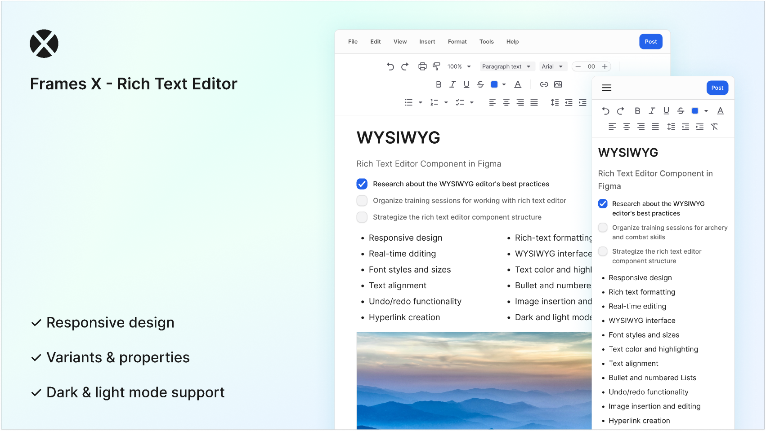
BO'LIM 03
Menyu va Toolbar
QAction orqali menyu va toolbar yaratish

Slide 9
MENYU VA TOOLBAR
QAction Tizimi
QAction nima?
Signallar
QAction - abstrakt foydalanuvchi interfeysi bo'lib, bir nechta interfeys elementlarini (menyu, toolbar, klaviatura) bitta ob'ektda birlashtiradi.
triggered
Action faollashganda (bosilganda) signal yuboriladi
Afzalliklari:
Bitta QAction ni menyu va toolbar ga qo'shish
toggled
Kod takrorlanishini kamaytirish
Checkable action holati o'zgarganda signal yuboriladi
Boshqarish osonlashadi
Klaviatura Qisqacha Yo'llari
QAction Xususiyatlari
action.setShortcut(QKeySequence("Ctrl+S"))
setText()
setStatusTip()
action.setShortcut(QKeySequence.Save)
Sarlavha
Status bar matni
action.setShortcut(Qt.CTRL + Qt.Key_S)
setIcon()
setCheckable()
Ctrl+S
Ctrl+O
Ctrl+N
Ctrl+C
Ctrl+V
Belgi (icon)
Belgilash mumkin
setShortcut()
setEnabled()
Klaviatura qisqacha yo'li
Faol/No faol
Eslatma: QAction menyu va toolbar da bir vaqtda ishlatilganda, bir tomonda o'zgarish ikkinchi tomonda ham aks etadi.

Slide 10
MENYU VA TOOLBAR
Menyu va Toolbar Yaratish
Menyu Yaratish
Toolbar Yaratish
# Menubar olish
# Toolbar yaratish
menu = self.menuBar()
toolbar = QToolBar("Main Toolbar")
# File menyu qo'shish
self.addToolBar(toolbar)
file_menu = menu.addMenu("&File")
# Belgi o'lchamini sozlash
# Action qo'shish
toolbar.setIconSize(QSize(16, 16))
file_menu.addAction(open_action)
# Action qo'shish
file_menu.addSeparator()
toolbar.addAction(open_action)
file_menu.addAction(exit_action)
toolbar.addSeparator()
toolbar.addWidget(QLabel("Hello"))
1
menuBar() - Menubar olish
1
QToolBar yaratish
2
addMenu() - Menyu qo'shish
2
addToolBar() - Qo'shish
3
addAction() - Action qo'shish
3
Har qanday widget qo'shish mumkin
Submenu va Separator
Status Bar
# Submenu yaratish
submenu = file_menu.addMenu("&Recent")
# Status bar o'rnatish
submenu.addAction(recent_action)
self.setStatusBar(QStatusBar())
# Separator qo'shish
# Xabar ko'rsatish
file_menu.addSeparator()
self.statusBar().showMessage("Ready")

Slide 11

BO'LIM 04
Fayl Operatsiyalari
Fayllarni ochish, saqlash va boshqarish

Slide 12
FAYL OPERATSIYALARI
QFileDialog bilan Ishlash
Asosiy Metodlar
Kod Namunasi
getOpenFileName()
Faylni ochish
defopen_file(self):
Bitta faylni tanlash uchun dialog oynasi
filepath, _ = QFileDialog.\
getOpenFileName(
self,
getOpenFileNames()
Ko'p fayllar
"Faylni ochish",
"",
Bir nechta fayllarni tanlash
"Text Files (*.txt)"
)
if filepath:
getSaveFileName()
Faylni saqlash
withopen(filepath, 'r') as f:
Faylni saqlash uchun dialog oynasi
content = f.read()
self.text_edit.setText(content)
getExistingDirectory()
Papka tanlash
Papkani tanlash uchun dialog
Saqlash
defsave_file(self):
Fayl Filtrlari
filepath, _ = QFileDialog.\
getSaveFileName(
# Bir nechta filtr
self,
"Text Files (*.txt);;All Files (*)"
"Faylni saqlash",
# Tasvirlar uchun
"",
"Images (*.png *.jpg);;All Files (*)"
"Text Files (*.txt)"
)
if filepath:
withopen(filepath, 'w') as f:
f.write(self.text_edit.toPlainText())

Slide 13
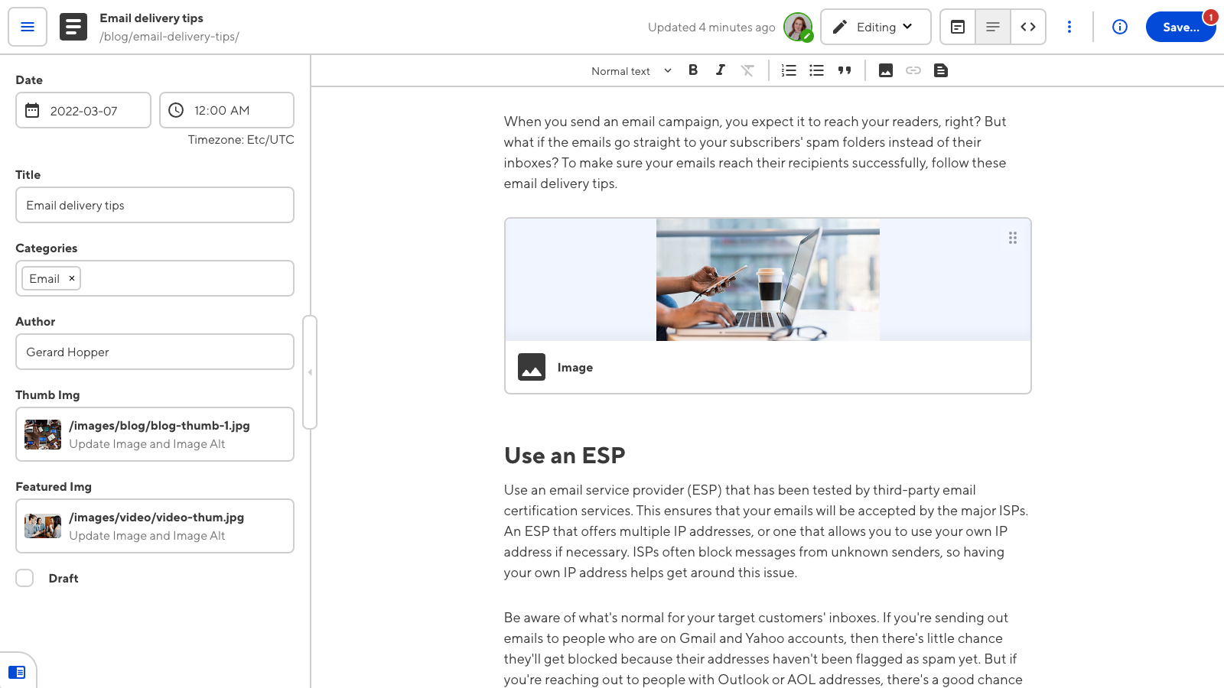
BO'LIM 05
Matn Formatlash
Matnni qalin, kursiv va ostiga chizish

Slide 14
MATN FORMATLASH
QTextCharFormat Formatlash
Qalin (Bold) Formatlash
Yordamchi Metod
defbold_text(self):
defmerge_format(self, format):
fmt = QTextCharFormat()
cursor = self.text_edit.textCursor()
weight = QFont.Bold if \
if not cursor.hasSelection():
self.action_bold.isChecked() \
cursor.select(
else QFont.Normal
QTextCursor.WordUnderCursor
fmt.setFontWeight(weight)
)
self.merge_format(fmt)
cursor.mergeCharFormat(format)
self.text_edit.mergeCurrentCharFormat(format)
Matn tanlanmagan bo'lsa, kursorni o'zida so'zni tanlaydi
Kursiv (Italic) Formatlash
defitalic_text(self):
Qo'shimcha Formatlash
fmt = QTextCharFormat()
fmt.setFontItalic(
setFontFamily()
self.action_italic.isChecked()
Shrift oilasi
)
self.merge_format(fmt)
setFontPointSize()
Shrift o'lchami
Ostiga Chizish (Underline)
setForeground()
Matn rangi
defunderline_text(self):
setBackground()
fmt = QTextCharFormat()
Fon rangi
fmt.setFontUnderline(
self.action_underline.isChecked()
)
self.merge_format(fmt)

Slide 15
BO'LIM 06
Xatolarni Boshqarish
GUI dasturlarida xatolarni qayta ishlash

Slide 16
XATOLARNI BOSHQARISH
Xatolarni Qayta Ishlash
Muammo
UncaughtHook Sinfi
GUI dasturlarida xatolar yuz berganda, ular konsolda ko'rinmay qolishi mumkin. Foydalanuvchi dastur nima uchun ishlamayotganini tushunmaydi.
import sys, traceback
from PyQt5.QtWidgets import QMessageBox
classUncaughtHook:
Odatiy xatti-harakat:
defexception_hook(
self, exc_type, exc_value, tb
•
Xatolar konsolda ko'rinadi
):
•
GUI yopilishi mumkin
log_msg = '\n'.join([
''.join(traceback.format_tb(tb)),
•
Foydalanuvchi xabarsiz qoladi
'{0}: {1}'.format(
exc_type.__name__, exc_value)
])
QMessageBox.critical(
None,
Yechim
'Xatolik yuz berdi',
str(log_msg)
sys.excepthook ni o'zgartirish orqali xatolarni ushlab, QMessageBox orqali foydalanuvchiga ko'rsatish.
)
sys.exit(-1)
# O'rnatish
hook = UncaughtHook()
Xatolarni ushlash
sys.excepthook = hook.exception_hook
Traceback ni saqlash
Dialog oynasida ko'rsatish
QMessageBox Turlari:
critical()
warning()
information()
question()
Maslahat: Xatolarni log fayliga yozish tavsiya etiladi.

Slide 17
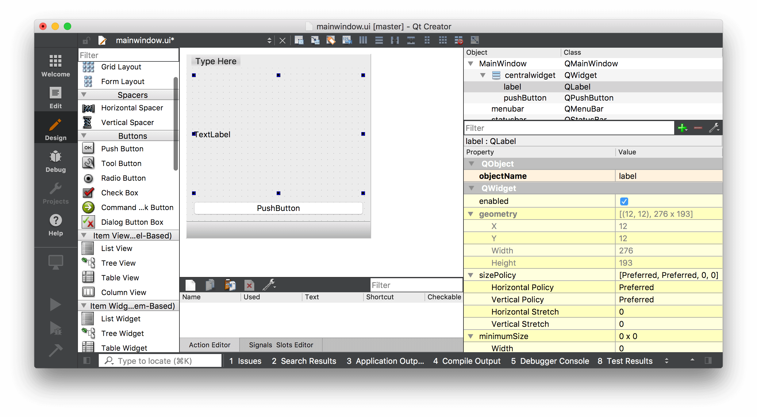
BO'LIM 07
Amaliy Misol
To'liq matn muharriri dasturi kodi

Slide 18
AMALIY MISOL
Matn Muharriri Dasturi
import sys
from PyQt5.QtWidgets import *
from PyQt5.QtGui import *
from PyQt5.QtCore import *
classTextEditor(QMainWindow):
def__init__(self):
super().__init__()
self.setWindowTitle("PyQt5 Matn Muharriri")
self.setGeometry(100, 100, 800, 600)
# Central widget
self.text_edit = QTextEdit()
self.setCentralWidget(self.text_edit)
# Create UI
self.create_actions()
self.create_menu()
self.create_toolbar()
self.create_statusbar()
defcreate_actions(self):
# File actions
self.action_new = QAction("&New", self)
self.action_new.setShortcut(QKeySequence.New)
self.action_new.triggered.connect(self.new_file)
self.action_open = QAction("&Open", self)
self.action_open.setShortcut(QKeySequence.Open)
self.action_open.triggered.connect(self.open_file)
self.action_save = QAction("&Save", self)
self.action_save.setShortcut(QKeySequence.Save)
self.action_save.triggered.connect(self.save_file)
self.action_exit = QAction("E&xit", self)
self.action_exit.setShortcut(QKeySequence.Quit)
self.action_exit.triggered.connect(self.close)
# Format actions
self.action_bold = QAction("&Bold", self)
self.action_bold.setShortcut("Ctrl+B")
self.action_bold.setCheckable(True)
self.action_bold.triggered.connect(self.bold_text)
self.action_italic = QAction("&Italic", self)
self.action_italic.setShortcut("Ctrl+I")
self.action_italic.setCheckable(True)
self.action_italic.triggered.connect(self.italic_text)
defcreate_menu(self):
menubar = self.menuBar()
file_menu = menubar.addMenu("&File")
file_menu.addAction(self.action_new)
file_menu.addAction(self.action_open)
file_menu.addAction(self.action_save)
file_menu.addSeparator()
file_menu.addAction(self.action_exit)
format_menu = menubar.addMenu("F&ormat")
format_menu.addAction(self.action_bold)
format_menu.addAction(self.action_italic)
defcreate_toolbar(self):
toolbar = QToolBar("Main")
self.addToolBar(toolbar)
toolbar.addAction(self.action_new)
toolbar.addAction(self.action_open)
toolbar.addAction(self.action_save)
toolbar.addSeparator()
toolbar.addAction(self.action_bold)
toolbar.addAction(self.action_italic)
defcreate_statusbar(self):
self.statusBar().showMessage("Tayyor")
defopen_file(self):
filepath, _ = QFileDialog.getOpenFileName(
self, "Faylni ochish", "", "Text Files (*.txt)")
if filepath:
withopen(filepath, 'r', encoding='utf-8') as f:
self.text_edit.setText(f.read())
self.statusBar().showMessage(f"Ochildi: {filepath}")
defsave_file(self):
filepath, _ = QFileDialog.getSaveFileName(
self, "Faylni saqlash", "", "Text Files (*.txt)")
if filepath:
withopen(filepath, 'w', encoding='utf-8') as f:
f.write(self.text_edit.toPlainText())
self.statusBar().showMessage(f"Saqlandi: {filepath}")
defbold_text(self):
fmt = QTextCharFormat()
weight = QFont.Bold if self.action_bold.isChecked() \
else QFont.Normal
fmt.setFontWeight(weight)
self.merge_format(fmt)
defmerge_format(self, format):
cursor = self.text_edit.textCursor()
if not cursor.hasSelection():
cursor.select(QTextCursor.WordUnderCursor)
cursor.mergeCharFormat(format)
self.text_edit.mergeCurrentCharFormat(format)
if __name__ == '__main__':
app = QApplication(sys.argv)
editor = TextEditor()
editor.show()
sys.exit(app.exec_())

Slide 19

XULOSA
Xulosa va Tavsiyalar
O'rganilgan Narsalar
Eng Yaxshi Amaliyotlar
PyQt5 asoslari va modullari
MVC arxitekturasidan foydalaning
QMainWindow arxitekturasi
Signal-slot mexanizmini qo'llang
QTextEdit va QPlainTextEdit
Xatolarni to'g'ri boshqaring
QAction va menyu/toolbar
Kodni modullarga bo'ling
Fayl operatsiyalari
Dokumentatsiyani o'qing
Matn formatlash
Xatolarni boshqarish
Foydali Manbalar
PyQt5 Documentation
Python GUIs
Qt for Python
doc.qt.io
pythonguis.com
doc.qt.io/qtforpython

